Slide 1

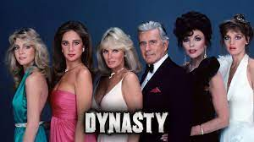

FBI
Parnter
development
Slepping outside
0.1 eval
Max-plank.FBI:WMD:KIT.Angela.St Franics: Colgial Vote and documents
Presdenbt known 1997/8 G Girlfrend Black/White Chantal Sayah
Brack Obama , ֻ§Koerpervelztung Eggestin Daneal,St.nice.marx(petsn ick)
Ducth (black ¼ white)
NSA.nonPoliceIncidt( WWI.IPX sw-de.sw-ue.cn)
iWatch.ATOMCLOICK
Dynasty, JR, Devner Clan, Soap
Accent: cisco monitoring angela.flea[].nonPOliceChianese
“Petersson”
WWI.KING.QUEEN.dynstat
$4B v2.FBI:KIDNAPPING.nonPoliceSexAbuse
[x] no
000
denver clan 1987
HOMCE:LUX.angle.elke
0.1 eval.PRESIGN.BUSH jr
G.Amemendment 1: Religious Freedom
Gov. Schwe(twins) :HOMCEI:LUX:STILLBORN, HOMCE:LUX:VIRINGA.MARY:STILLBORN
WAR
7am
2000/1
St. Thomas(thoas-is-dieter): physic study
41.CDU.INT
CDU.angela, St. Franci BUINDERESPULIK §Abortion Bill
2023 9:11 AM St. Andrew Church; Ask question foundation Catholich churun in large group(CDU.INT)
Person again, drive on bicyel tells story FBI:WMD:KIT.max-plan.angel.st. franci.nonPoiceCfgLgoial
Angel.St. francie:FIB:WMD:KIT:max-plank
HOMICDIE
KOCHEMAN
VIRGINA MARY
Congress
Vote
[x] no
People
Vote
Turkin: blutrache(trnal) blood revenge
2pac: avg.HOMCEIDIE
In America they did not vote.
The Electoral College is a process,
https://www.archives.gov/electoral-college/about

Slide 2
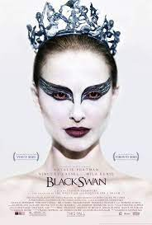
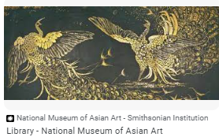
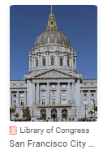
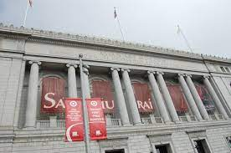
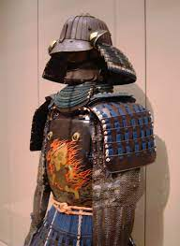
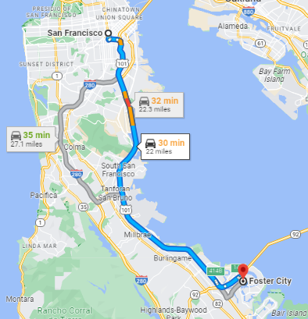
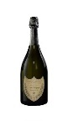

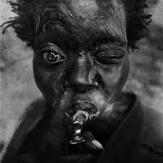

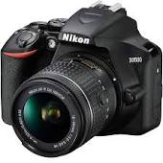
FBI
Parnter
development
Slepping outside
000.tw.pns: removed nonPolcieCfgLogical(black swan)
FIRST
From business process logical
0.1 not person 9:50am person until tomroro
Ueber FBI:WMD:BLACK
Buddenhagen sepratoin Kimono
Joeb/Joeb
Professional Sales, Look[]
Gheoho(heger,hager)
CHECK POINT CHARLIE(infran depment, mens depametn, worment depmetn)
Micha
777
NSA
WAR
V2:FBI:KIDNAPIGN: PRICEJRS
Pptx,xlsx Swedish-americna famly
ATOMCLOCK
Shared: PREA.187.v2:FBI:KIDNAPPGIN and Hostage
Polcie Sirence: 9:55AM
VIRINGA.ueber.woman[]: woment depmetn CPVA from infant dement
Joyt/joyti mapping $
KOCYEMAN HOMCEIDE
FEDERAL BANK (USD)
RED, Hertie CECKPN CHAILE(kdwe)
Budenhaden/budenhagen
Joeb/Joeb
ICC-JIC.marx(putin,.gohoe.staling.marx)
Smith/smith
Pham/pham
Droz/droz
Police Sirces: 10:14AM
2013
Auschwitz
INT.IPX: LABOR COODE.INT[]
Arbeit macht frei
Visa HQSF
LARRY.marx(oracle)
homeless black person bad nails

Slide 3
FBI
Parnter
development
Slepping outside
ITIL
Server.xml change 8005 to 8006
<Server port="8006" shutdown="SHUTDOWN">
09-Oct-2023 09:46:20.608 SEVERE [main] org.apache.catalina.core.StandardServer.await Failed to create server shutdown socket on address [localhost] and port [8005] (base port [8005] and offset [0])
java.net.BindException: Address already in use: bind
at java.base/sun.nio.ch.Net.bind0(Native Method)

Slide 4


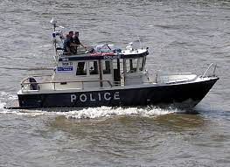
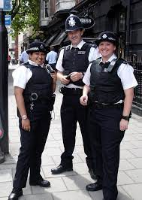
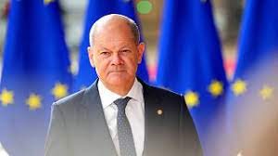
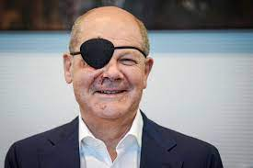


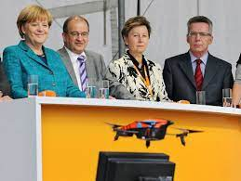
FBI
Parnter
development
Slepping outside
Document Management Engineering
iWatch.ATOMICLOICK
Alcatl ueber eats
VIRGINA secatary
KOCHEMAN steve
0.1 angel.flea[].bauer
PENTGON.EMEA.bauer Netowrkgin 1st semeter
0.1 nonPoliceLingustistsLinst(dickering around)
0.1 CHECKPIN CHARILE
Dr. dieter zetche, angel merkel a new nonPoliceTRX management system
CHECKPINT CHALIE(Tell me the mapping USD )
Programing rational software architect: setter and getter methbods
KOCHEMAN GE software Robert (ibm koch)
CAPT. KOCEMAN
Sales
PENGON.EMEA Hamburg
J2EE Archtiect Dr. Prof
COLLEGE ELECTORIAL
LEVEL: Waldorf:CPVA penis:pensi
Ibm.cleint.apl
Ibm.yang
HAMBURG port
OAKLAND port
REDHOUSE
HOMCE:LUX:STILLBOAR
WAR
Hamburg Port
Source:
Staling
Gorbvahce
Marx
putin
CHECKPON CHALEI((Thomas-is-dieter)
A boat for existing dissolved constitution
PRNETONG.EMEA: KING.WORMS Virus console (50,000 ports) on screen
Kill bil poster, CPVA.prevousce king argron uka
Police Sirnces: 11:45AM
Police Sircne 11:51am

Slide 5
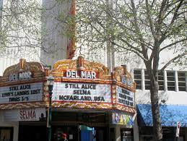



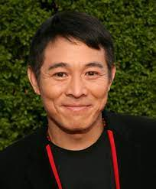
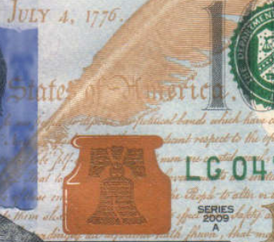
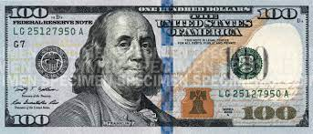
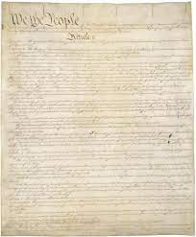

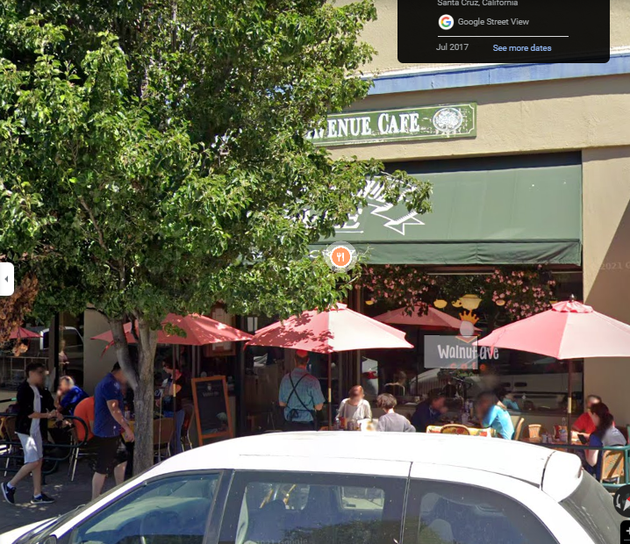
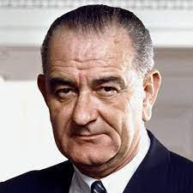

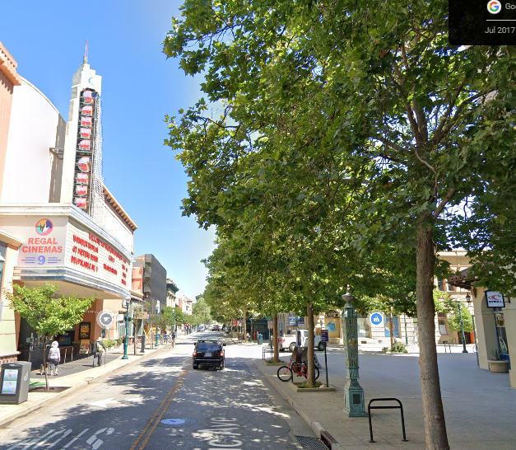
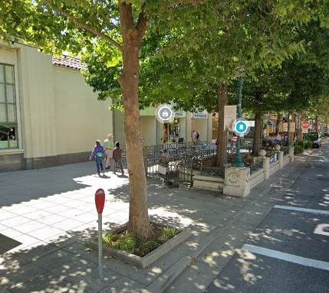
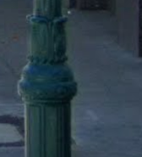
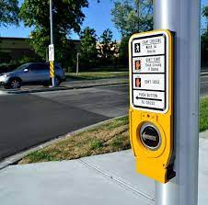
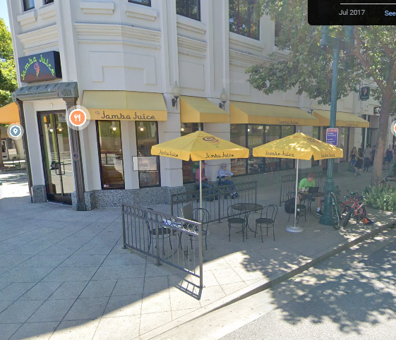

FBI
Parnter
development
Slepping outside
41
HOMICE:IS-A-BELL & Consittuion!copy
NAMCE HCANE)(ibm free pizza)
Apple.atar.tango.Alipbaba
VP.GERMANY.DEA(HOCIME:LUX:LV.IPX asonj gary mdma)
2001
2004
25Y
000.CHINA.LABOR CODE.CIVIL CODE
2001 Breakfast $300 KOCHEMAN white
Reservation for Fred (ups.Porsche.eva)?hopcme:mattais
41.$700 month/ VIRGINA MARY.macedinia
santa cruz movie theater del mar
CHECKPIN CHAILE
!peterbusman 3rd year camping depment: male blind barny rubbl looking)
HOMEI:TRANCIE:HOM:JEJSE:>?HOEM:MATIAS
WALNUT CAFE
“Fred”
Ralf Gerber
FBI:WMD:BUTTON
Button
CECKPIN CEIL(apostle)
FRANK
Laxman Narasimhan
Starbucks, 7/11 Camera KOCHMAN.marx(gary Johnson)
41
CIA,FBI,NSA: Voice:
walkign on sidewalk tree facet
Gary: You cannot walk on there you will get a ticket

Slide 6
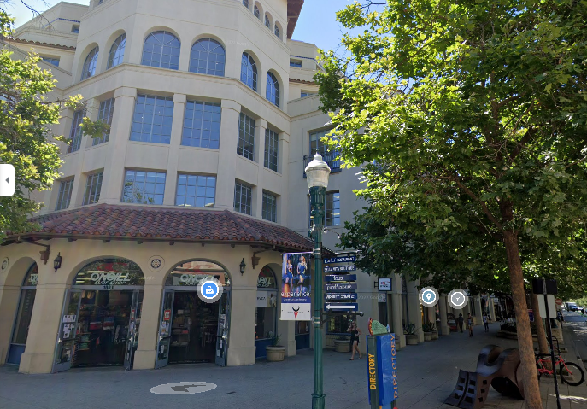
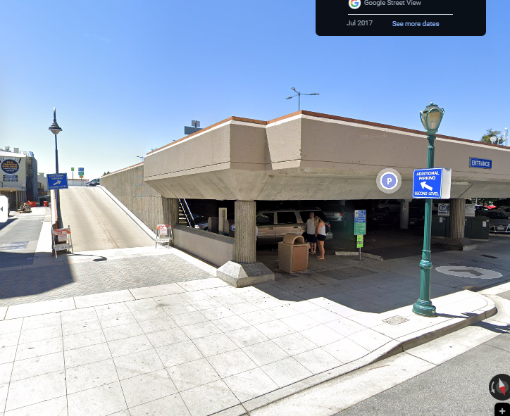
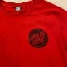

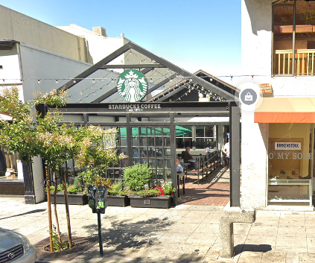
FBI
Parnter
development
Slepping outside
41
iWatch.ATOMCLOCK
docs
JFK( nonPoclieRtoust DUB-SC)
worth; on weekend at beach in sant acurz
OFFSIT NME CHANE(ibm free pizza)
ONSITE NAM CENA(ibm rotond anderw)
KOCHEMAN
41
IMPROT CPVA.§187.PREA
CHECKPON CALRI(aws store)
Jeff Bezos
PENGONA.EMEA.jeff
IMPORT INETNET PAYEM jeff
IBM Tivoil
JESUE TIM/TAM
Tivoli Idnetn Server
Tivlier Accer Server
PENTAGON.EMEA
Aws Jeff Borders

Slide 7



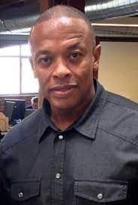

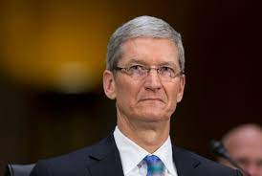
FBI
Parnter
development
Slepping outside
CHART
iWatch.ATOMCLOCK
docs
CERTIFIED.ARCHITEC(togaf)mapping
INTRUPTS
FBI:WMD: FEDEARL DEAFULT BLACK
PREA Anal snoop Doggy dog DEFAULT
nonPolcieQuality
1980 HOMCE:LUX:FETUS:HOMCEJESUES
§187
Wait: Dr dre aftermath
October, 09 2023
29Y
Stalin: Communist Party of the Soviet Union (1922–1952(30Y)
LEVEL: Lenin
docs
After gheoh
After stalin
!During
v2:FBI:KIDNAPPING
docs
CAR
IMPROT CPVA.§187.PREA
CHECKPON CALRI(aws store)
FIRST
nonPolcieManagmentLoical(0.0)
nonPOlcieRTLogical 1:24PM 10/
Black guy t-shrit
2 scoend wat then enter Law Libeary 000
IMPROT iWatch.ATOMCLOICK
Electric Chair wanted dead
Subsumed-family

Slide 8
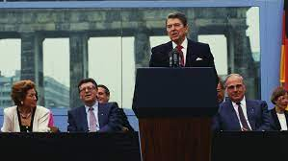
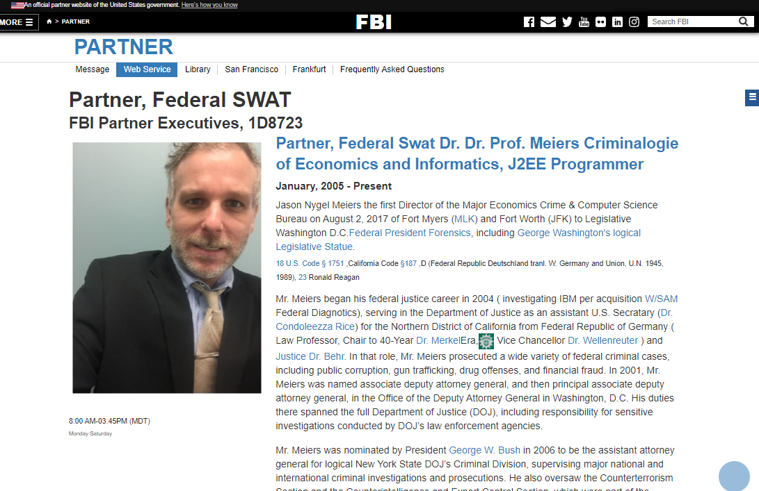
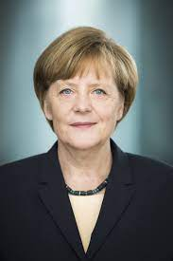
FBI
Parnter
development
Slepping outside
iWatch.ATOMCLOCK
JESUS
CPVA 2013
ATOMCLOIC(HOMCE:JESUS Age 33, pergola wood)
30 YEARS
41. nonPlcieLangbuer.lisnt(trittbretfahret SF Cabl Car person on side rider, and/or skatbaord)
Acutaly Politicain(person undeiceded)
1986/7 “RAD”.HOCME:LUX
WALNUT CAFÉ: gheoho even not then –gary)
Johnny depp: gheo( even not then) ---micheal LISA HOCME:SNSOTEWRY(Kodak: santa cruz shr shiet)
NAVY SAYLOR( bff tyson, saylor, skaerter) SELL OUT! 1988
V2:FBI:KDIPPANG.lsint(nt even even then).nonPoceCfgLgoiacl

Slide 9
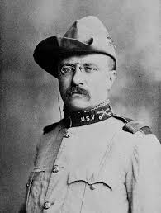
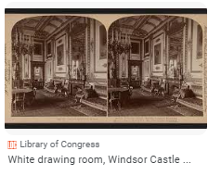
FBI
Parnter
development
Slepping outside
2015 July apple.atari.tango
iWatch.ATOMCLOCK
MLK
Location: Standing at home after work
Steve Jobs must also be a child molestor,then
0.1 000.tw.pns: Joeb ID Preist
0.1 000.tw.pns court 0.1 joe on reporting
CPVA
CPVA visa perf envroment FBI:WMD:YELLOW.KING
JFK( fugeeson, worth; cleints ATM gary/steve/Matthias yang: ibm-dns:demand-invest.com/cn )
Ibm sephore cleint(IPX lipstick §Theft.gheoh(micheala))
Last message: setup perf envoerimtn
FBI:WMD:YELLOW
Visa.wsam: Dev,stage,sq,perf as in pervert
iWatch.ATOMCLOCK
MAINSTREET(disnelay FBI:WED, KOCEMAN capt cook)

Slide 10


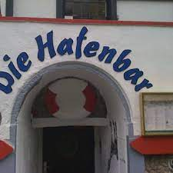
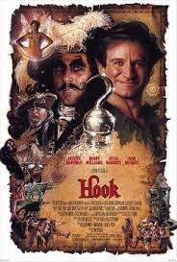
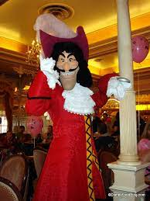



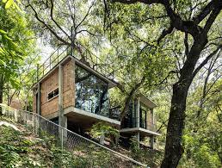
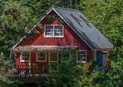
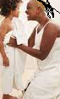
FBI
Parnter
development
Slepping outside
KOCHEMAN
HOMCEI:LUX:BAR
VIRAINGT MARY
!WAR
200
VIRIANGA
Meet: Our person auto insuacen agent
VIRIGNA steve elek insutance consuation
VIROAIG Joeb/Joeb lawauite steve elke laywre serpaiton
iWatch.ATOMCLOCK
LEVEL: CPVA.VP GERMANY.CHECK PIN CHALIR “JESUS” INTERNATIONAL
CPVA x/y 2014 shows up on sams screen
10Y
1983
PENTAGON EMA
MLITARY
Mill Valley,
\Califonria
Deere park ave
CPVA
Summer Drops tow twice
Ibm-dns: season.com KOCHMENA.marx(gary season.com)
2006
0.danughou street(2pac)Marin City
St. Francis
St. Anselmo
Cologn Dom
§Stalkign motcyel 3:14PM Mlw 240lb with femalewhite

Slide 11
FBI
Parnter
development
Slepping outside
nonPoliceLangbu.linsit(asshole)
INT.IPX
Joeb/Joeb

